Slide 1
HIGH VOLTAGE ENGINEERING
Mini-Project
ABB EMF 60 kV Inductive Voltage Transformer
Participants: Intro-groups 765-12 & 766-12
<number>/37

Slide 2
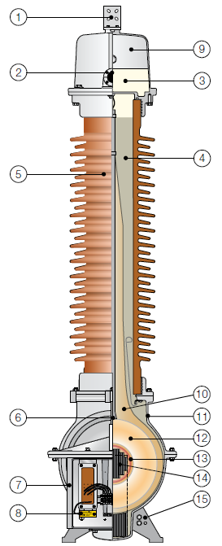
Components
<number>/37
1 | Primary terminal | 9 | Expansion system
2 | Oil level sight glass | 10 | Paper insulation
3 | Oil | 11 | Tank
4 | Quartz filling | 12 | Primary winding
5 | Insulator | 13 | Secondary winding
6 | Lifting lug | 14 | Core
7 | Secondary terminal box | 15 | Ground connection
8 | Neutral end terminal

Slide 3
Characteristics
<number>/37
Highest voltage for equipment | 72 kV
Design | Inductive type
Installation | Outdoor
Insulation | Oil-paper-quartz
Insulators | Porcelain
Voltage factor | Up to 1.9/8 hours
Creepage distance | ≥ 25 mm/kV
Ambient temperature | -40°C to +40°C
Design altitude | Maximum 1000 m
Nominal flash-over and creepage distance
Flash-over distance [mm] | Creepage distance [mm] | Protected creepage distance [mm]
630 | 2248 | 1020
Test voltage IEC 61869-3 (SS-EN 60044-2)
Highest voltage for equipment (Um) [kV] | 1 min wet/dry [kV] | LIWL 1.2/50 us [kV] | RIV test voltage [kV] | RIV level [uV]
72.5 | 140 | 325 | 46 | 125

Slide 4


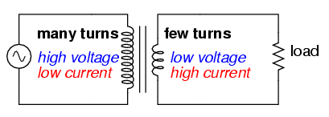
Test 1 : Transfer Ratio Measurement
<number>/37
A transformer can be described as a device that transfers energy from one
circuit to another via mutal induction.
The number of turns on each winding determines the transfer ratio between
the primary and the secondary.
Step down transformer

Slide 5
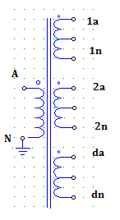
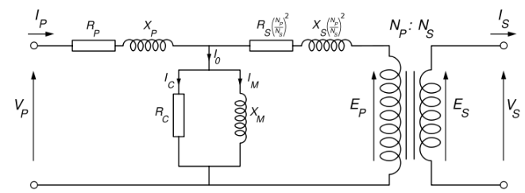
Test 1 : Transfer Ratio Measurement
<number>/37
Setup
Equivalent circuit of a transformer
Vs = Vp – ΔVp

Slide 6
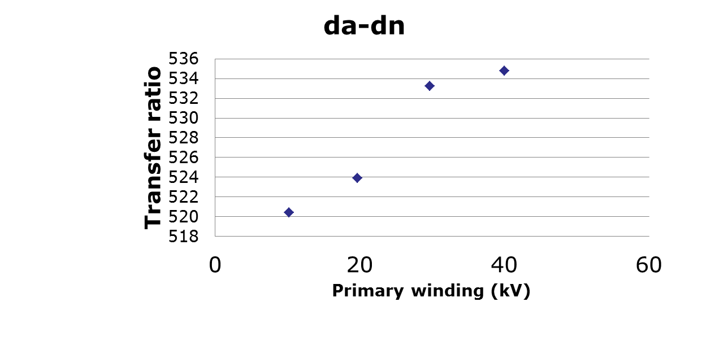
Test 1 : Transfer Ratio Measurement
<number>/37
Results

Slide 7
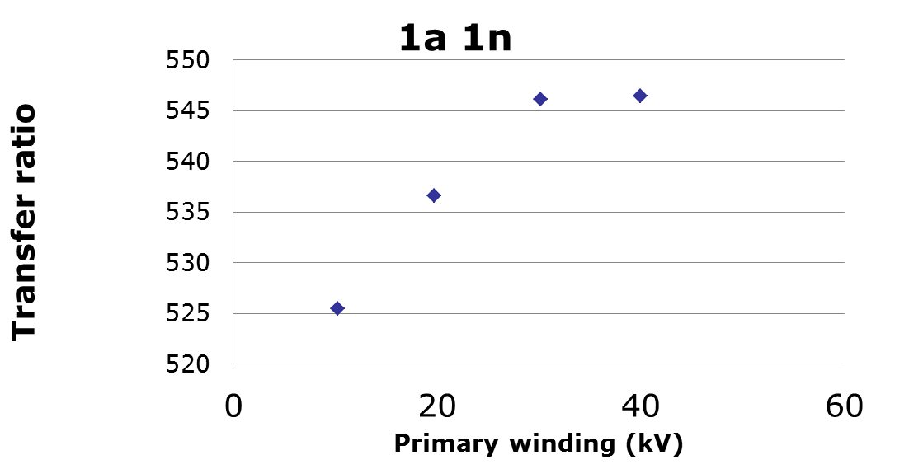
Test 1 : Transfer Ratio Measurement
<number>/37
Results

Slide 8
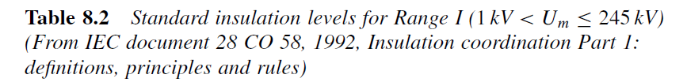
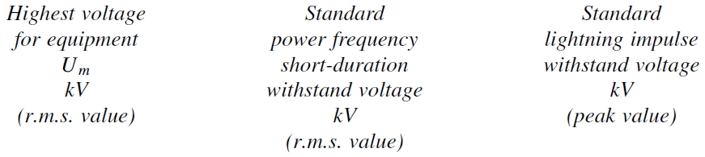
Test 2 : Power frequency test
<number>/37
To assess the ability of the transformer insulation to withstand under the system’s power frequency voltage, it is subjected to 1-minute test under 50 Hz. The test voltage is set at a level higher than the expected working voltage in order to be able to simulate the stresses likely to be encountered over the years of service. For routine testing, the voltage levels for power-frequency testing are always related to the highest r.m.s. phase-to-phase voltage of power transmission systems.

Slide 9
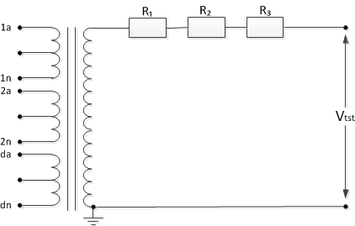
Test 2 : Power frequency test
<number>/37
R₁=51,1kΩ
R₂=1MΩ
R₃=282kΩ
Vtst=140kV Vtst=97,78kV for 1min
f=50Hz

Slide 10
Test 2 : Power frequency test
<number>/37
For the Power Frequency test to be passed the transformer should withstand the testing voltage Vtst for 1 min without electrical breakdown in the insulation of the transformer.
During the test the transformer ABB EMF 60 kV withstood 1 minute under 98,78kV and did not show any signs of electrical breakdown in its insulation.
As a conclusion the transformer ABB EMF 60 kV passed the Power Frequency test.

Slide 11

Test 3 : Lightning Impulse Voltage
Lightning strokes on transmission lines induce steep rising voltages in the lines and set up traveling waves along them causing possible damage to the systems insulation. In order to assure that the insulation of the system will respond properly to a lightning stoke it must be subjected to a Lightning Impulse Voltage.

Slide 12
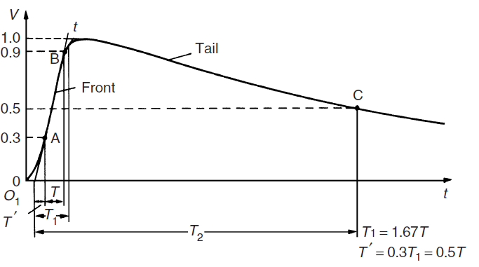
Test 3 : Lightning Impulse Voltage
<number>/37
Full Standard Lightning Impulse Voltage

Slide 13
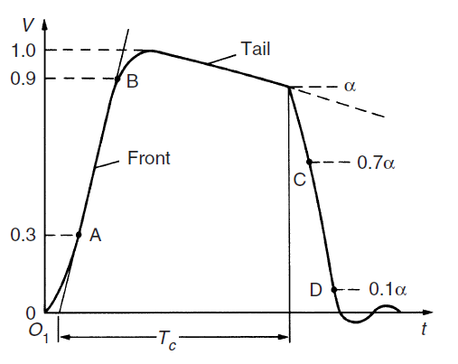
Test 3 : Lightning Impulse Voltage
<number>/37
Standard tail-chopped lightning impulse voltage

Slide 14
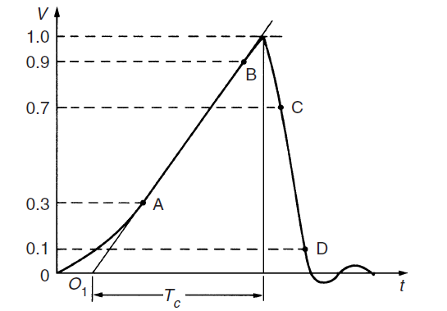
Test 3 : Lightning Impulse Voltage
<number>/37
Standard front-chopped lightning impulse voltage

Slide 15
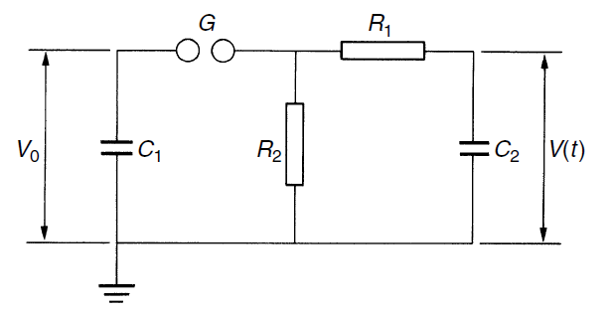
Test 3 : Lightning Impulse Voltage
<number>/37
Setup
485 Ω
9500 Ω
1000 pF
120 pF

Slide 16
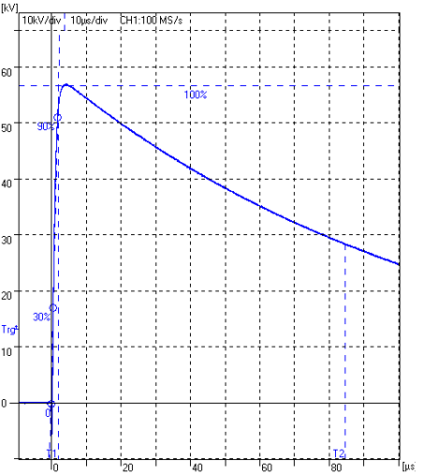
Test 3 : Lightning Impulse Voltage
<number>/37
Result 1:
Up = 56.951 kV
T1 = 2.0991us
T2 = 84.606us

Slide 17
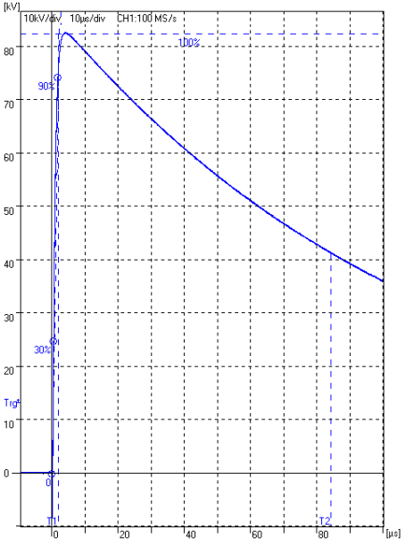
Test 3 : Lightning Impulse Voltage
<number>/37
Result 2:
Up = 82.680 kV
T1 = 2.1030us
T2 = 84.414us

Slide 18
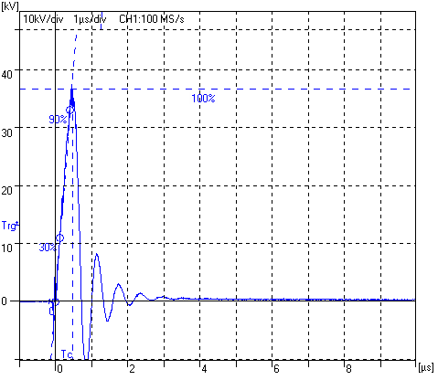
Test 3 : Lightning Impulse Voltage
<number>/37
Result 3:
Up = 36.879 kV
T1 = 0.45890us
T2 = 0.48044us

Slide 19
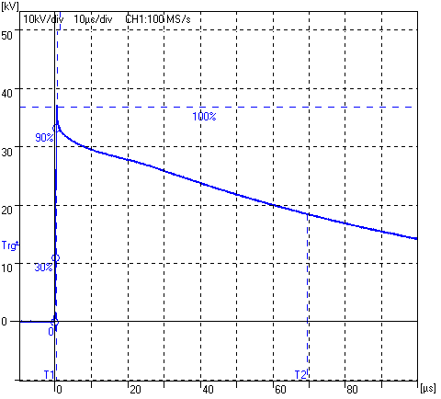
Test 3 : Lightning Impulse Voltage
<number>/37
Result 4:
Up = 37.014 kV
T1 = 0.46815us
T2 = 69.662us

Slide 20
Test 4 : Dielectric loss angle measurements
20/38
Scope :
Understand the purpose for measuring the loss angle
Be capable to assess the results and get the right information by the loss angle for our test object

Slide 21
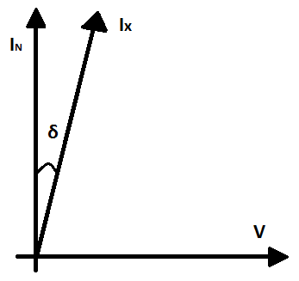
Test 4 : Dielectric loss angle measurements
<number>/38
All kinds of dielectrics and insulation materials are characterized by a capacitance (C) and a magnitude of power dissipation, also called loss factor (tan δ).
Due to the dielectric losses the current through the capacitor leads the voltage by an angle (90-δ) which is only slightly less than 90°.
One of the most commonly used methods for measuring tan δ with high precision is the high-voltage Schering bridge.

Slide 22
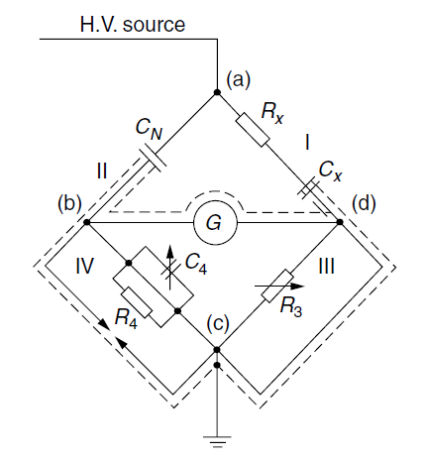


Test 4 : Dielectric loss angle measurements
<number>/38
The bridge measures the loss angle of a capacitor by comparing it with a gas-filled standard capacitor C_{N} which has very low and nearly negligible loss over a wide frequency range.
C_{N} is the ideal capacitor
C_{X} is the unknown capacitor ( in our case ABB EMF 60 KV inductive voltage transformer)
(a)-(b) and (a)-(d) are the H.V parts
(b)-(c) and (c)-(d) are the L.V parts
R_{X} is a hypothetical resistance which represents the actual power loss in the actual capacitor
R₄ ,C₄ and R₃ are necessary to balance the bridge
Schering bridge scheme

Slide 23
Test 4 : Dielectric loss angle measurements
<number>/38
Measurement 1
Voltage (V) kV | 5.05 | 14.87 | 10.23 | 19.78 | 24.6
Capacitance (C_{x}) pF | 19.17 | 19.28 | 19.22 | 19.25 | 19.27
Loss angle (tanδ) | 0.075 | 0.08 | 0.078 | 0.0817 | 0.082
Angle (δ) ⁰ | 4.29 | 4.57 | 4.46 | 4.67 | 4.69
These measurements are taken with a dummy made small capacitor and the ideal gas capacitor.

Slide 24
Test 4 : Dielectric loss angle measurements
<number>/38
Measurement 2
Voltage (V) kV | 10.2
Capacitance (C_{x}) pF | 130.08
Loss angle (tanδ) | 0.52
Angle (δ) ⁰ | 27.47
Measurement 3
Voltage (V) kV | 10.32 | 20.55
Capacitance (C_{x}) pF | 75.98 | 87.41
Loss angle (tanδ) | -0.014 | -0.141
Angle (δ) ⁰ | -0.8 | -8.025
δ is too high due to ground connection
(the output is connected to the frame of the transformer which is grounded)
Connected with 2N winding (The output is connected to the high voltage winding and to the one of the low voltage windings)

Slide 25
Test 5 : Partial discharge measurement
<number>/38
5.1 Scope
To gain knowledge about the partial discharge phenomena
To measure partial discharges on test objects
To distinguish between different type of PDs as:
    Internal discharges
    External (surface) discharges
    Corona discharges

Slide 26
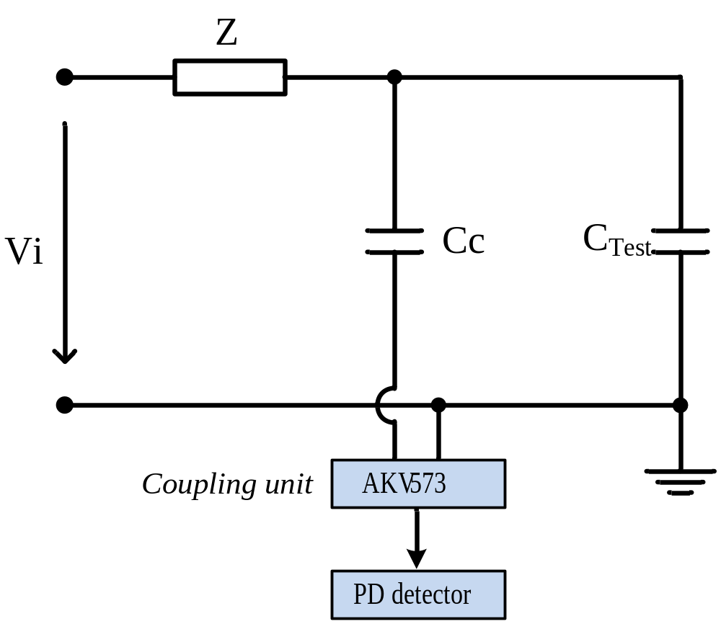
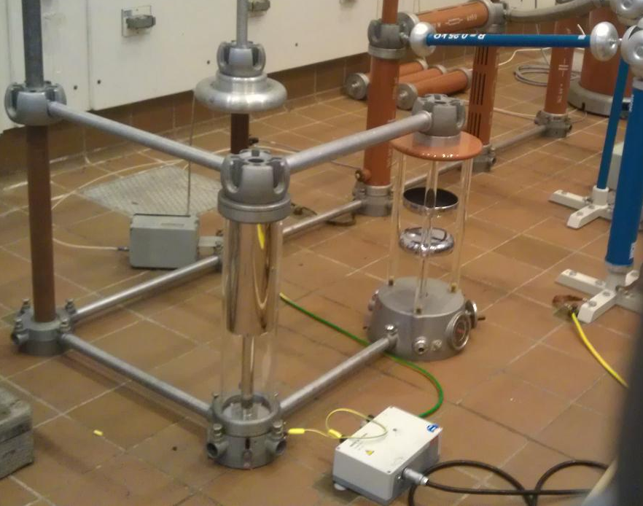
Test 5 : Partial discharge measurement
<number>/38
5.2 Electrical diagram

Slide 27
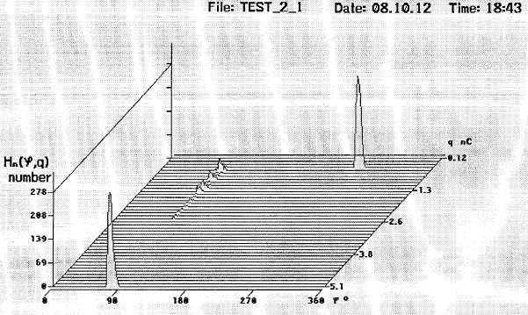
Test 5 : Partial discharge measurement
<number>/38
5.3.1 Experiments – two plates
0 deg
360 deg
180 deg
Surface discharges (at the peak value)

Slide 28
Test 5 : Partial discharge measurement
<number>/38
5.3.2 Experiments – pointed rod, grounded plate
Surface discharge at 90 degrees, although in tests the PD was identified at 270 degree resulting that the PD measurements are sensitive
0 deg
360 deg
180 deg

Slide 29
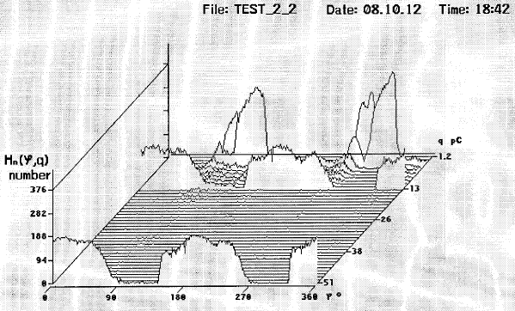
Test 5 : Partial discharge measurement
<number>/38
5.3.3 Experiments – homemade capacitor
0 deg
360 deg
180 deg
Internal discharges (at zero crossings) are identified

Slide 30
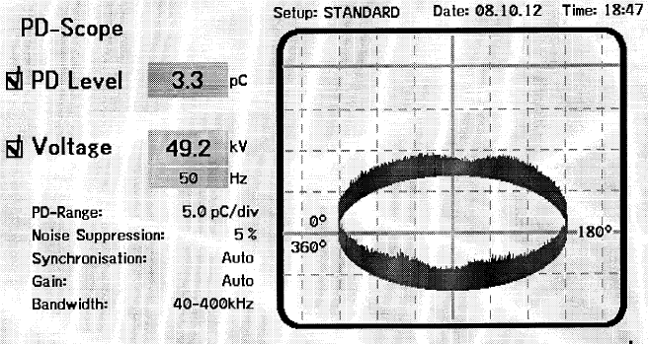
Test 5 : Partial discharge measurement
<number>/38
5.3.4 Experiments – VT
No discharges are identified except the background noise

Slide 31
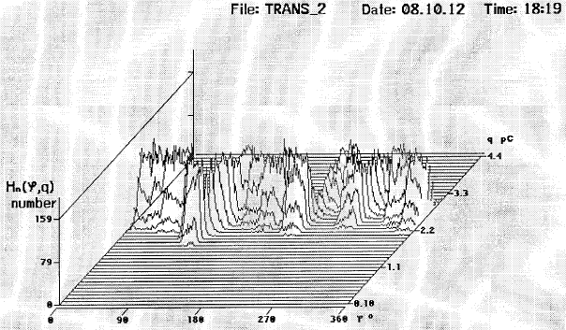
Test 5 : Partial discharge measurement
<number>/38
5.3.4 Experiments – VT
No discharges are identified except the background noise

Slide 32
Test 5 : Partial discharge measurement
<number>/38
5.4 Conclusions
The experiments shows how to measure and how to differentiate the types of PD
The measurements are sensitive to imperfections (scratches) on the electrodes (plates) resulting in shifted characteristics of discharges
The reference background noise is identified in the range of 1-3 pC due to poor or imperfect contacts
The value of the internal PD shows the quality of the dielectric

Slide 33
Test 6 : Dielectric spectroscopy
<number>/38
Dissipation factor (tanδ) is used to evaluate losses in the insulator materials and indicates its quality (and/or ageing)
Dielectric properties of insulators (dielectrics) can be measured and quantified in the frequency domain using AC voltages at different frequencies
For oil-paper-insulated power transformers, the dielectric frequency response consist from 3 components:
  response of the cellulose insulation
  the response of the oil
  the interfacial polarization effect

Slide 34
Test 6 : Dielectric spectroscopy
<number>/38
Goal:
dielectric spectroscopy test for insulation diagnosis is made in order to determine transformer ageing, moisture, oil quality, the nature and the magnitude of the losses
Interpretation:
The frequency range of 1000 - 10 Hz is dominated by the cellulose insulation effect
The frequency range of 0.01 - 10 Hz is dominated by the oil conductivity effect
The frequency range <0.01 Hz is dominated by insulation geometry, ratio of oil to pressboard and moisture

Slide 35
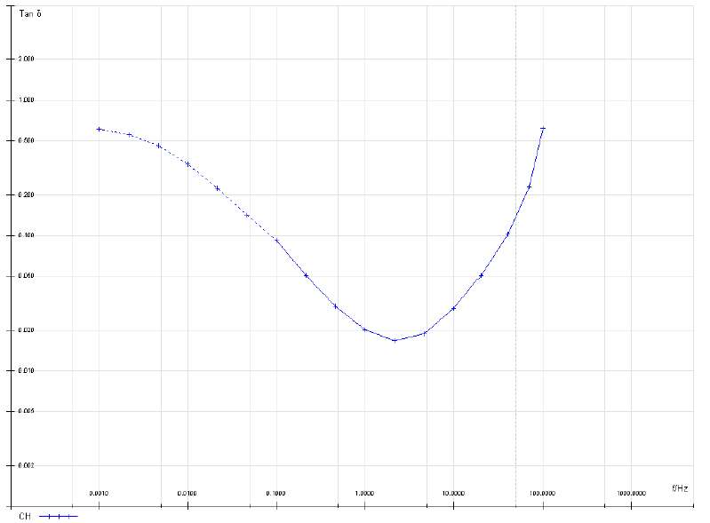
Test 6 : Dielectric spectroscopy
<number>/38
Test
results
tanδ as a function of f

Slide 36
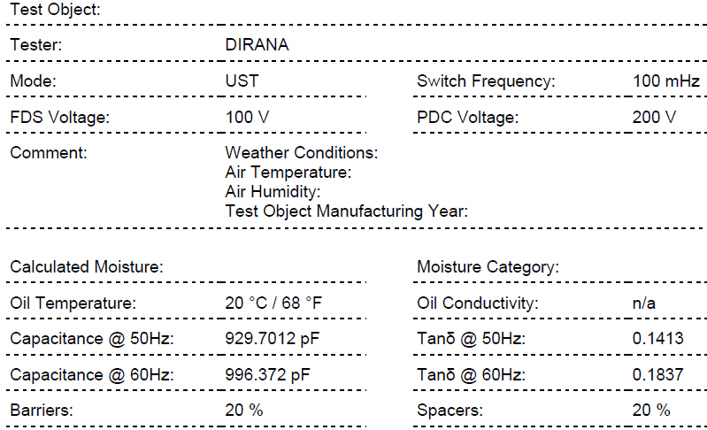
Test 6 : Dielectric spectroscopy
<number>/38
Test results
δ=8º
δ=10.5º

Slide 37
Test 6 : Dielectric spectroscopy
<number>/38
Test results
Moisture: 4.9 % (wet)
Oil: 29 % (good)
Conclusion
Electrical losses in dielectrics are determined by polarization or conduction losses and they produce heat.
Dielectric spectroscopy allows for the most comprehensive diagnostic and evaluation of insulation systems.
Comparison of transformer tanδ – f curves at different time intervals provides a good overall view regarding its aging.

Slide 38
End of presentation
<number>/38
Time for discussion and questions
Thanks for your attention !

